Slide 1

COURSE: B.Sc. (PROGRAMME) IN ECONOMICS
PAPER NAME –MICROECONOMICS II
TOPIC –THEORIES OF INTEREST
YEAR- THIRD SEMESTER-5 SESSION -2022-2023
DATE OF LECTURE: 13/09/2022
PREPARED BY
DR. KAMALIKA CHAKRABORTY
ASSISTANT PROFESSOR (DEPARTMENT OF ECONOMICS)
KHATRA ADIBASI MAHAVIDYALAYA, BANKURA, WEST BENGAL

Slide 2
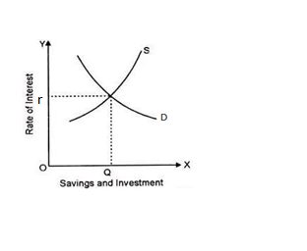
THEORIES OF INTEREST
Classical Theory of Interest or Demand and Supply of Capital Theory of Interest: This theory was expounded by eminent economists like Prof. Pigou, Prof. Marshall, Walras, Knight etc. According to classical view have said that “the rate of interest is determined by the supply and demand of capital. Therefore, those economists who hold classical view have said that “the rate of interest is determined by the supply and demand of capital.

Slide 3
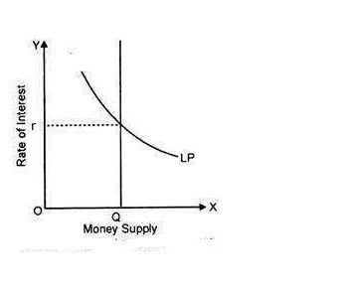
Liquidity Preference Theory of Interest by Keynes: According to Keynes, Interest is purely a monetary phenomenon. It is the reward of not hoarding but the reward for parting with liquidity for the specified period. In Liquidity Preference Theory interest is determined by the supply of and demand for money. In the eyes of Keynes—"Interest is the reward for parting with liquidity for a specific period.”
The desire for liquidity arises because of three motives:
(i) The transaction motive;
(ii) The precautionary motive; and
(iii) The speculative motive.

Slide 4
Productivity Theory of Interest: This theory was propounded by J.B. Clark and F.H. Knight. According to this theory, interest is the reward paid to capital due to its productivity.
Abstinence Theory of Interest: This theory was expounded in 18th century by an eminent economist N. W. Senior. According to this theory interest is the reward for abstinence from present consumption.
The Time- Preference Theory”: John Rae expounded this theory in the year 1834. Further, Bohm Bawerk developed this theory in an elaborate way. Bohm-Bawerk, an Austrian economist, is the main exponent of this theory which seeks to explain interest on the basis of time-preference.
Fisher’s Time Preference Theory: Prof. Fisher’s Time Preference Theory is the modified theory of Bohm-Bawerk. Interest rate depends on time-preference or an eagerness to spend income on present consumption.

Slide 5
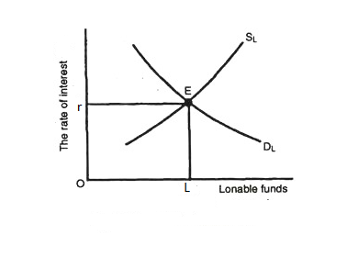
The Loanable Fund Theory of Interest: The Neo-classical or the Loanable Fund Theory was expounded by the famous Swedish economist Knot Wick-sell. Further, this theory was elaborated by Ohlin, Roberson, Pigou and other new-classical economists. This theory is an attempt to improve upon the classical theory of Interest. According to this theory, the rate of interest is the price of credit which is determined by the demand and supply for loanable funds.

Slide 6
THANK YOU

